Slide 1
Data Warehousing Design
Transparencies
Notes:
September 98
1
Chapter Name

Slide 2
Designing Data Warehouses
To begin a data warehouse project, need to find answers for questions such as:
  Which user requirements are most important and which data should be considered first?
  Should project be scaled down into something more manageable?
  Should infrastructure for a scaled down project be capable of ultimately delivering a full-scale enterprise-wide data warehouse?

Slide 3
Designing Data Warehouses
For many enterprises, the way to avoid the complexities associated with designing a data warehouse is to start by building one or more data marts.
Data marts allow designers to build something that is far simpler and achievable for a specific group of users.

Slide 4
Designing Data Warehouses
Few designers are willing to commit to an enterprise-wide design that must meet all user requirements at one time.
Despite the interim solution of building data marts, goal remains same: i.e., the ultimate creation of a data warehouse that supports the requirements of the enterprise.

Slide 5
Designing Data Warehouses
Requirements collection and analysis stage of a data warehouse project involves interviewing appropriate members of staff (such as marketing users, finance users, and sales users) to enable identification of prioritized set of requirements that data warehouse must meet.

Slide 6
Dimensionality Modeling
Logical design technique that aims to present the data in a standard, intuitive form that allows for high-performance access
Uses the concepts of ER modeling with some important restrictions.
Every dimensional model (DM) is composed of one table with a composite primary key, called the fact table, and a set of smaller tables called dimension tables.

Slide 7
Dimensionality Modeling
Each dimension table has a simple (non-composite) primary key that corresponds exactly to one of the components of the composite key in the fact table.
Forms ‘star-like’ structure, which is called a star schema or star join.

Slide 8
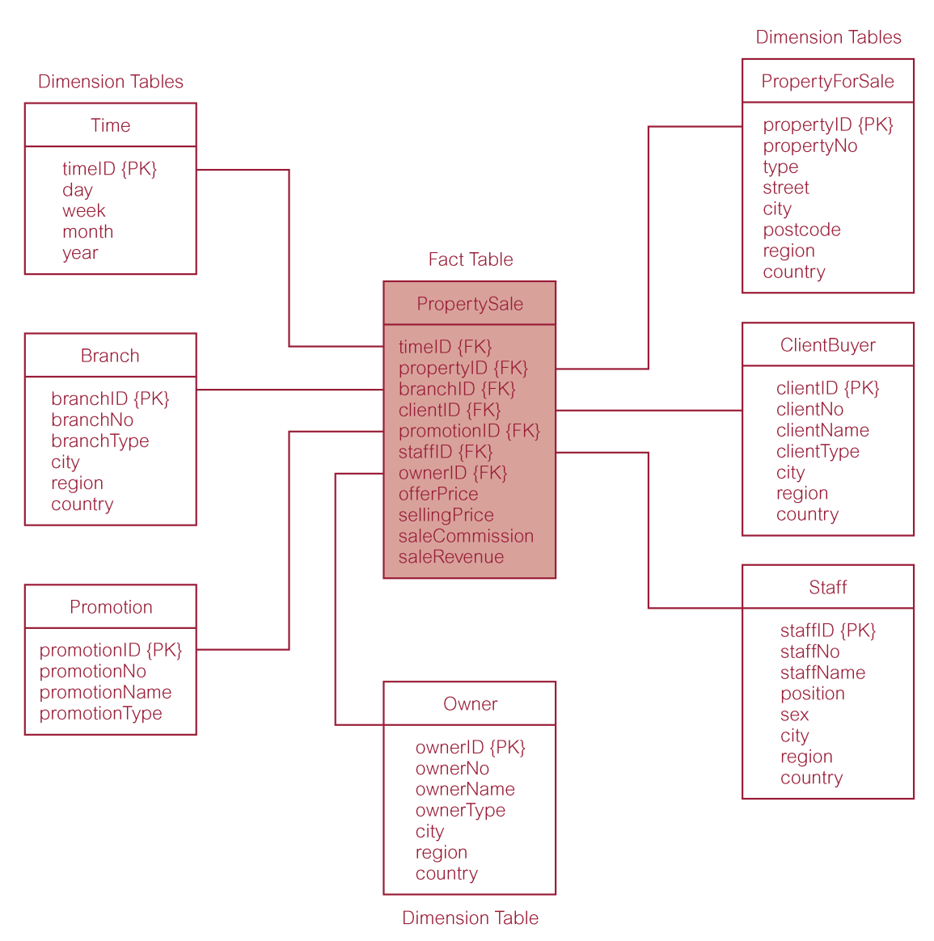
Star Schema for Property Sales of DreamHome

Slide 9
Dimensionality Modeling
Star schema is a logical structure that has a fact table containing factual data in the center, surrounded by dimension tables containing reference data, which can be denormalized.
Facts are generated by events that occurred in the past, and are unlikely to change, regardless of how they are analyzed.

Slide 10
Dimensionality Modeling
Bulk of data in data warehouse is in fact tables, which can be extremely large.
Important to treat fact data as read-only reference data that will not change over time.
Most useful fact tables contain one or more numerical measures, or ‘facts’ that occur for each record and are numeric and additive.

Slide 11
Dimensionality Modeling
Dimension tables usually contain descriptive textual information.
Dimension attributes are used as the constraints in data warehouse queries.
Star schemas can be used to speed up query performance by denormalizing reference information into a single dimension table.

Slide 12
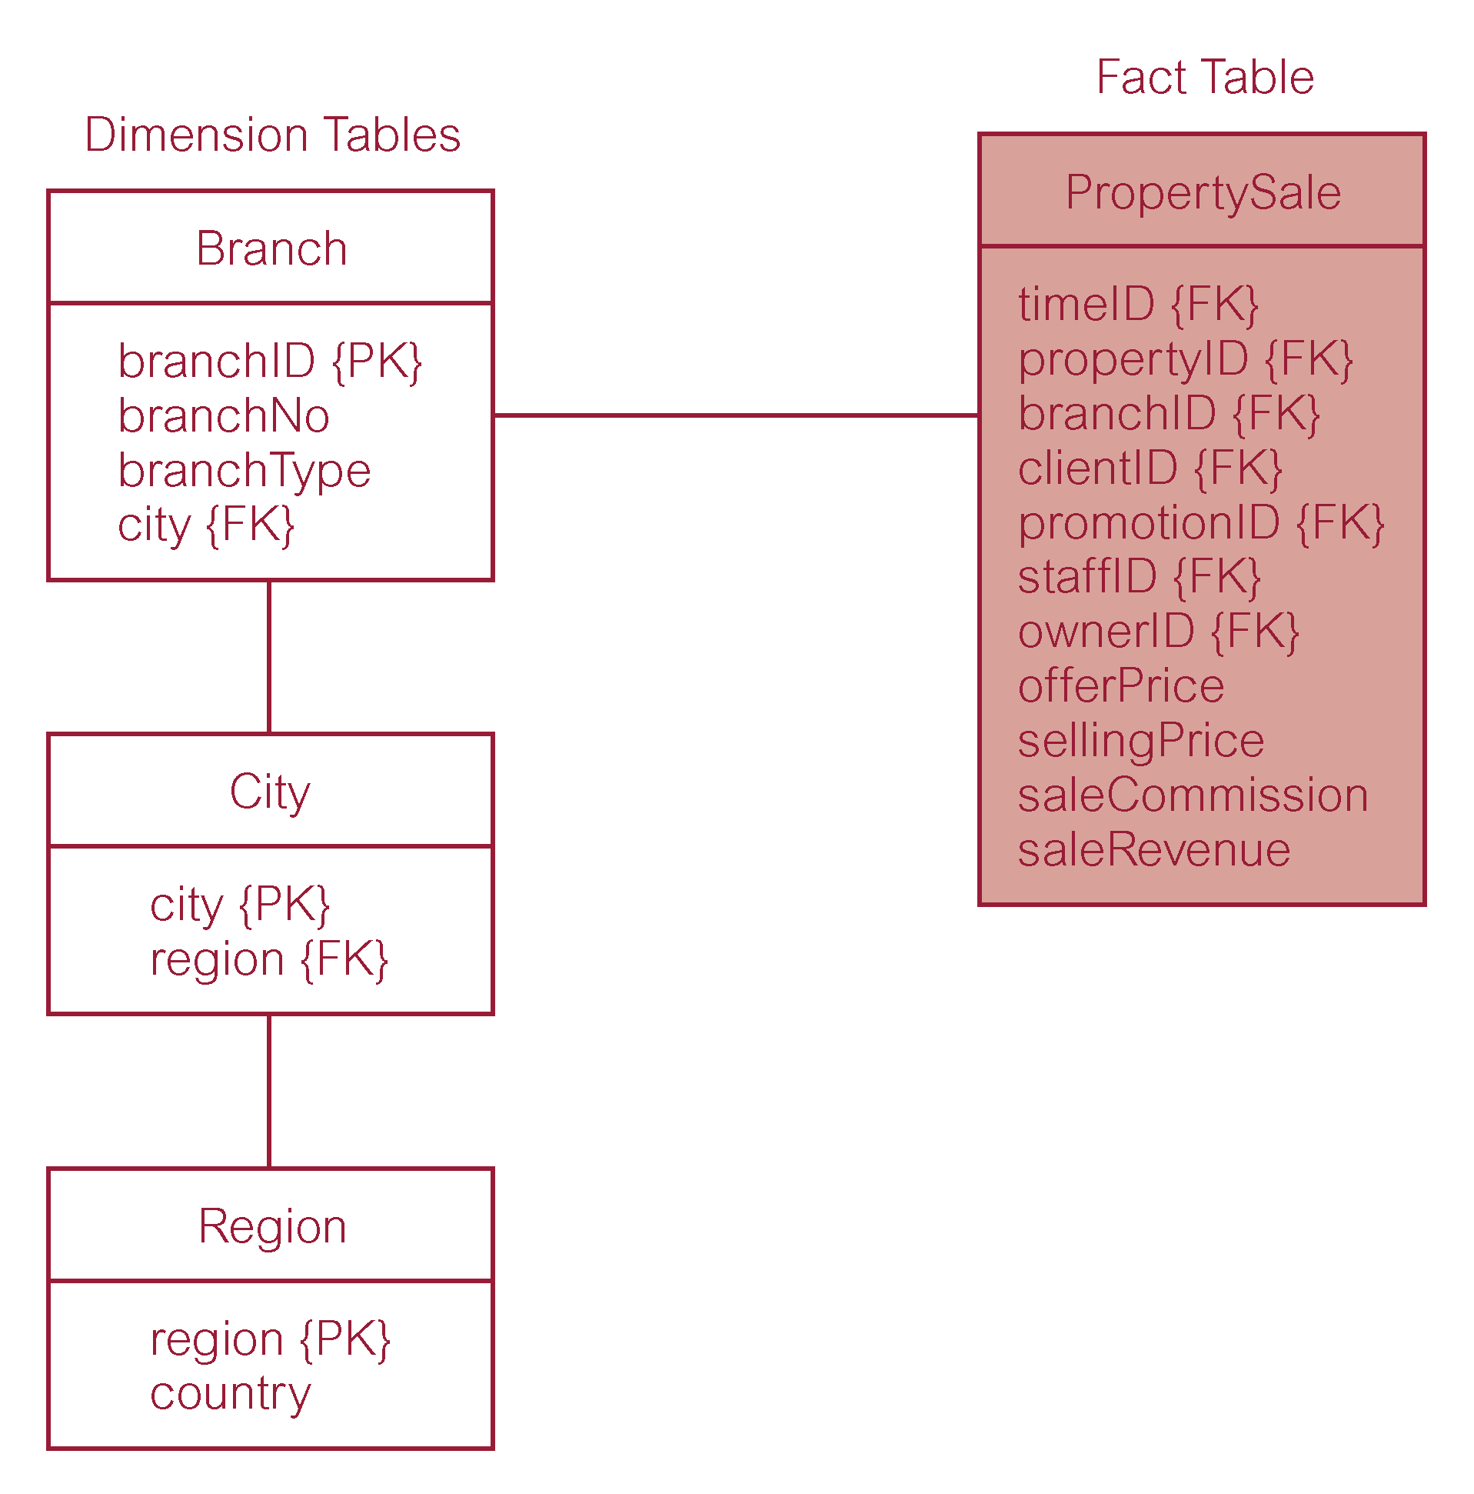
Property Sales with Normalized Version of Branch Dimension Table

Slide 13
Comparison of DM and ER models
A single ER model normally decomposes into multiple DMs.
Multiple DMs are then associated through ‘shared’ dimension tables.

